Slide 1
NoSQL and MongoDB
Prepared by referencing the following
https://docs.mongodb.com/manual/tutorial/

Slide 2
A database Management System provides the mechanism to store and retrieve the data. There are different kinds of database Management Systems: 1. RDBMS (Relational Database Management Systems) 2. OLAP (Online Analytical Processing) 3. NoSQL (Not only SQL)

Slide 3
introduction to NoSQL
A NoSQL originally referring to non SQL or non relational is a database that provides a mechanism for storage and retrieval of data. This data is modeled in means other than the tabular relations used in relational databases.
NoSQL databases are different than relational databases like MySql. In relational database you need to create the table, define schema, set the data types of fields etc before you can actually insert the data. In NoSQL you don’t have to worry about that, you can insert, update data without creating schema.

Slide 4
NoSQL
NoSQL is a non-relational DMS
Does not require a fixed schema, avoids joins, and is easy to scale.
The purpose of using a NoSQL database is for distributed data stores
NoSQL is used for Big data and real-time web apps
For example, companies like Twitter, Facebook, Google collect terabytes of user data per day
NoSQL database stands for "Not Only SQL" or "Not SQL.“
Traditional RDBMS uses SQL syntax to store and retrieve data for further insights
NoSQL can store structured, semi-structured, unstructured and polymorphic data (in one collection we have many versions of document schema)

Slide 5
Features of NoSQL
Non-relational
NoSQL databases never follow the relational model
Never provide tables with flat fixed-column records
Work with self-contained aggregates or BLOBs
Doesn't require object-relational mapping and data normalization
No complex features like query languages, query planners, referential integrity joins, ACID
Schema-free
NoSQL databases are either schema-free or have relaxed schemas
Do not require any sort of definition of the schema of the data
Offers heterogeneous structures of data in the same domain

Slide 6
Types of NoSQL Databases
Key-value Pair Based
Column-oriented Graph
Graphs based
Document-oriented

Slide 7
Types of NoSQL database: Types of NoSQL databases and the name of the databases system that falls in that category are:
MongoDB falls in the category of NoSQL document based database.
Key value store: Memcached, Redis, Coherence
Tabular: Hbase, Big Table, Accumulo
Document based: MongoDB, CouchDB, Cloudant
Graph based: AllegroGraph, Amazon Neptune etc

Slide 8
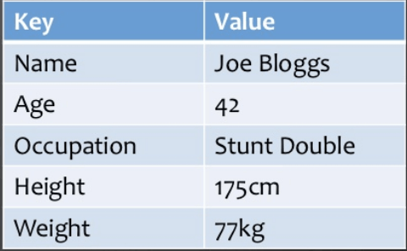
Key Value Pair Based

Slide 9
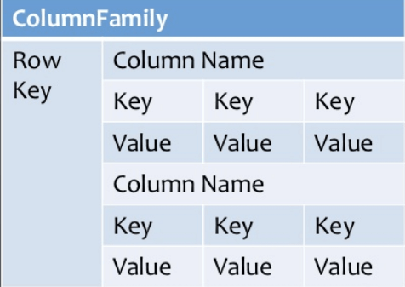
Column-oriented Graph

Slide 10
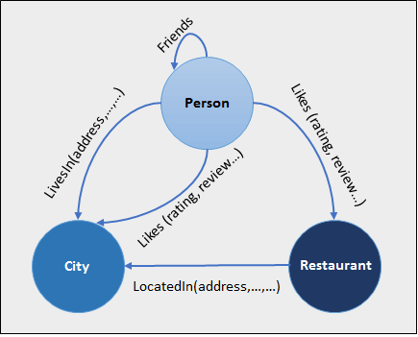
Graphs based

Slide 11
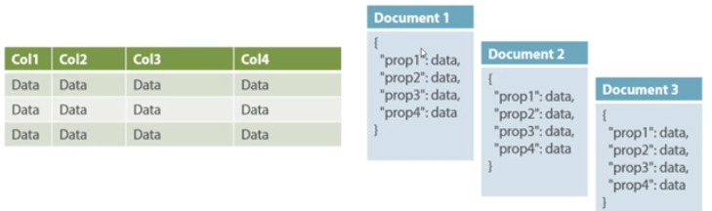
Document-oriented

Slide 12
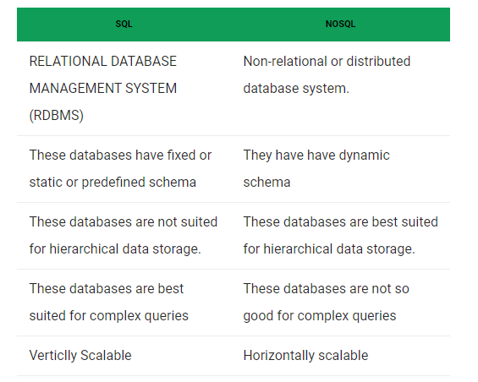

Slide 13
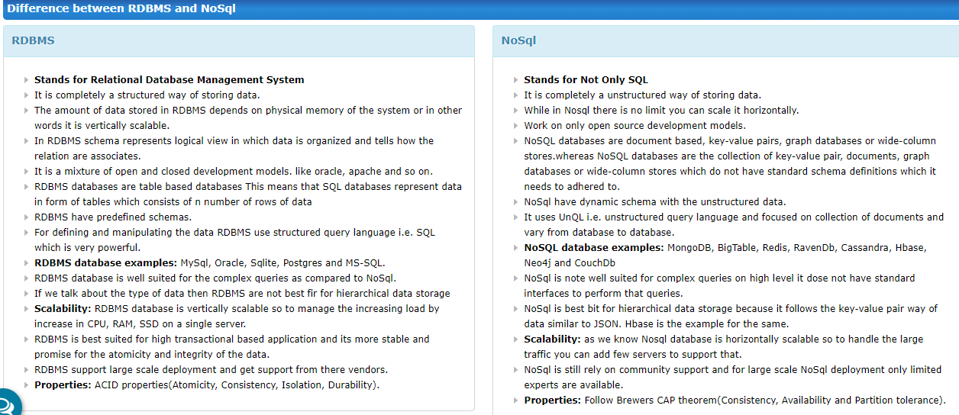

Slide 14
Advantages of NoSQL: There are many advantages of working with NoSQL databases such as MongoDB and Cassandra. The main advantages are high scalability and high availability.
High scalability – NoSQL database use sharding for horizontal scaling. Partitioning of data and placing it on multiple machines in such a way that the order of the data is preserved is sharding. Vertical scaling means adding more resources to the existing machine whereas horizontal scaling means adding more machines to handle the data. Vertical scaling is not that easy to implement but horizontal scaling is easy to implement. Examples of horizontal scaling databases are MongoDB, Cassandra etc. NoSQL can handle huge amount of data because of scalability, as the data grows NoSQL scale itself to handle that data in efficient manner.
High availability – Auto replication feature in NoSQL databases makes it highly available because in case of any failure data replicates itself to the previous consistent state.

Slide 15
Disadvantages of NoSQL: NoSQL has the following disadvantages.
Narrow focus – NoSQL databases have very narrow focus as it is mainly designed for storage but it provides very little functionality. Relational databases are a better choice in the field of Transaction Management than NoSQL.
Open-source – NoSQL is open-source database. There is no reliable standard for NoSQL yet. In other words two database systems are likely to be unequal.
Management challenge – The purpose of big data tools is to make management of a large amount of data as simple as possible. But it is not so easy. Data management in NoSQL is much more complex than a relational database. NoSQL, in particular, has a reputation for being challenging to install and even more hectic to manage on a daily basis.
GUI is not available – GUI mode tools to access the database is not flexibly available in the market.
Backup – Backup is a great weak point for some NoSQL databases like MongoDB. MongoDB has no approach for the backup of data in a consistent manner.
Large document size – Some database systems like MongoDB and CouchDB store data in JSON format. Which means that documents are quite large (BigData, network bandwidth, speed), and having descriptive key names actually hurts, since they increase the document size.

Slide 16
Introduction to MongoDB
MongoDB is a cross-platform open-source document-oriented database program
MongoDB database's has the ability to scale up with ease and hold very large amounts of data.
MongoDB stores documents in collections within databases.
MongoDB uses JSON-like documents
In MongoDB, each document stored in a collection requires a unique _id field that acts as a primary key.
BSON is a binary serialization format used to store documents on MongoDB

Slide 17
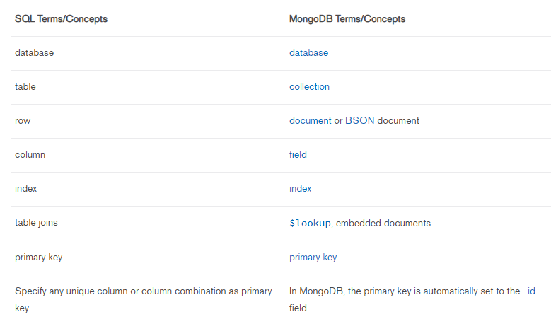
SQL to MongoDB Mapping Char

Slide 18
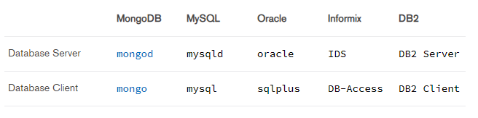
Database executables

Slide 19
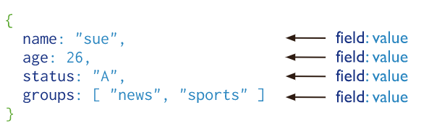
Document Database
A record in MongoDB is a document, which is a data structure composed of field and value pairs. MongoDB documents are similar to JSON objects. The values of fields may include other documents, arrays, and arrays of documents

Slide 20
The advantages of using documents are:
Documents (i.e. objects) correspond to native data types in many programming languages.
Embedded documents and arrays reduce need for expensive joins.
Dynamic schema supports fluent polymorphism.

Slide 21
Collections/Views/On-Demand Materialized Views
MongoDB stores documents in collections. Collections are analogous to tables in relational databases.
In addition to collections, MongoDB supports:
Read-only Views (Starting in MongoDB 3.4)
On-Demand Materialized Views (Starting in MongoDB 4.2).

Slide 22
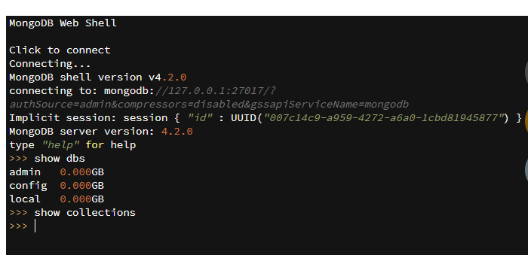

Slide 23
MongoDB CRUD Operations
C-create/insert
R-query
U- update
D-delete
Create or insert operations add new documents to a collection.
If the collection does not currently exist, insert operations will create the collection.
MongoDB provides the following methods to insert documents into a collection:
db.collection.insertOne() New in version 3.2
db.collection.insertMany() New in version 3.2

Slide 24
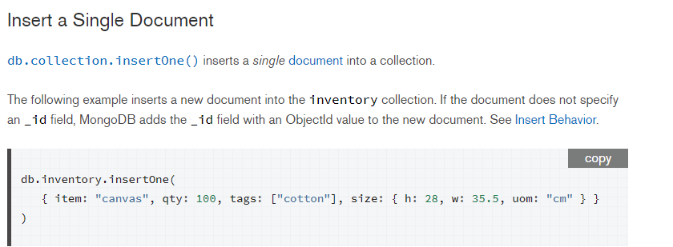
embedded

Slide 25
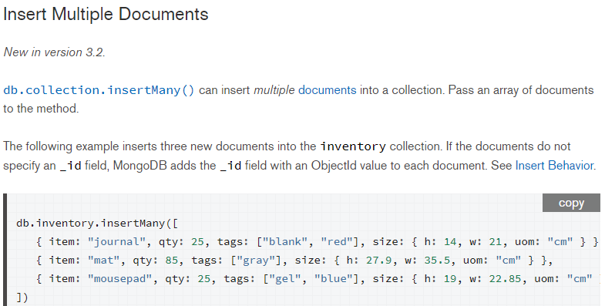

Slide 26
Query documents
Select All Documents in a Collection
To select all documents in the collection, pass an empty document as the query filter parameter to the find method. The query filter parameter determines the select criteria:
db.inventory.find({})
This is equivalent to select * from inventory

Slide 27
Specify Equality Condition
To specify equality conditions, use <field>:<value> expressions
in the query filter document
db.inventory.find ( { status : ”D” } )
This is equivqlent to
Select * from inventory where status=“D”;

Slide 28
Specify Conditions Using Query Operators
The following example retrieves all documents from the inventory
collection where status equals either "A" or "D"
db.inventory.find ( { status : { $in : [ “A” , ”D” ] } } )
You can express it using $or operator also
db.inventory.find ( { status : { $or : [ “A” , ”D” ] } } )

Slide 29
Specify AND Conditions
A compound query can specify conditions for more than one field in the collection’s documents.
Implicitly, a logical AND conjunction connects the clauses of a compound query so that the
query selects the documents in the collection that match all the conditions.
The following query finds all the documents in the inventory whose status is “D” and quantity is less than 30
db.inventory.find ( { status :”D” , qty: { $lt:30 } } )

Slide 30
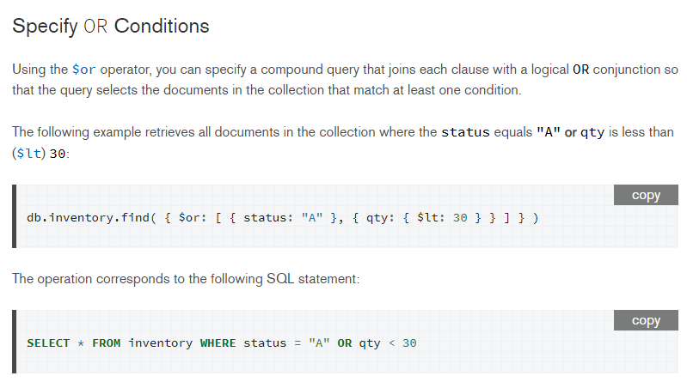

Slide 31
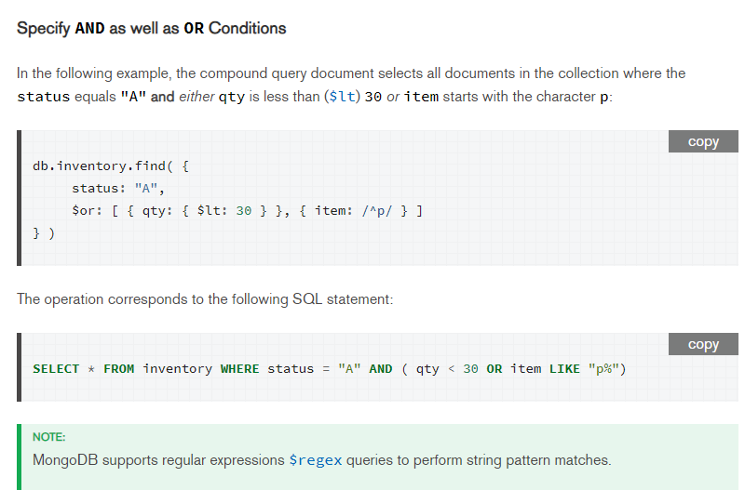

Slide 32
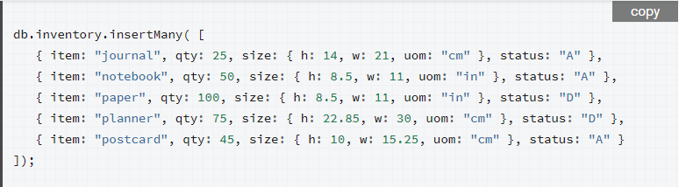
Query on Embedded/Nested Documents
Populate the collection

Slide 33
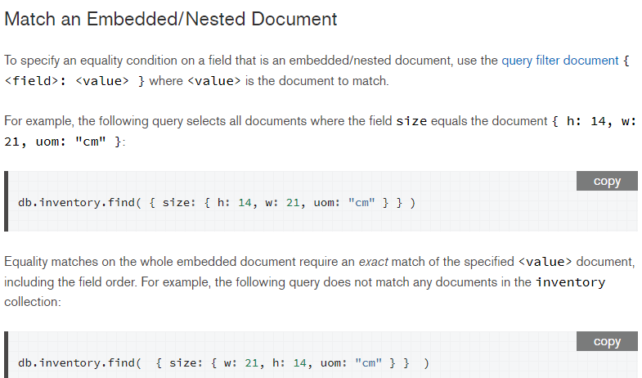

Slide 34
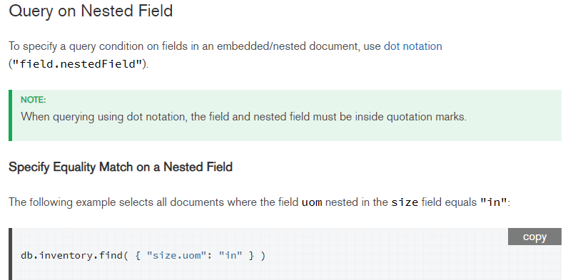

Slide 35
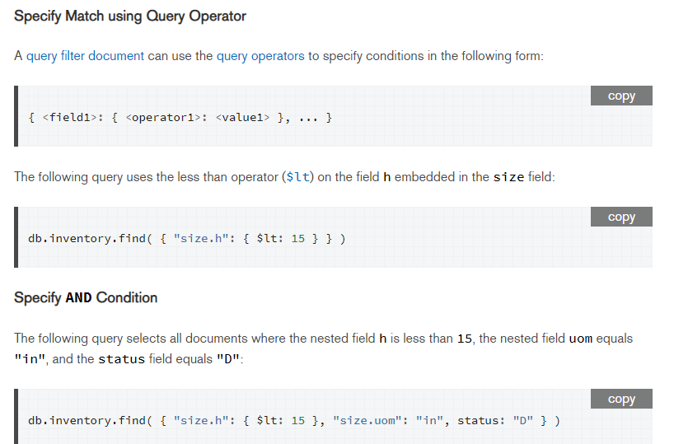

Slide 36
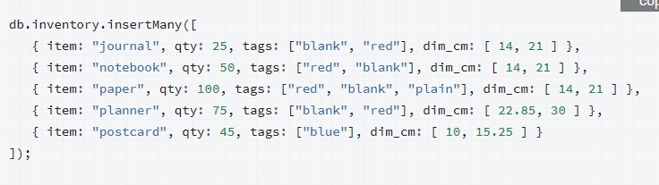
Query an Array

Slide 37
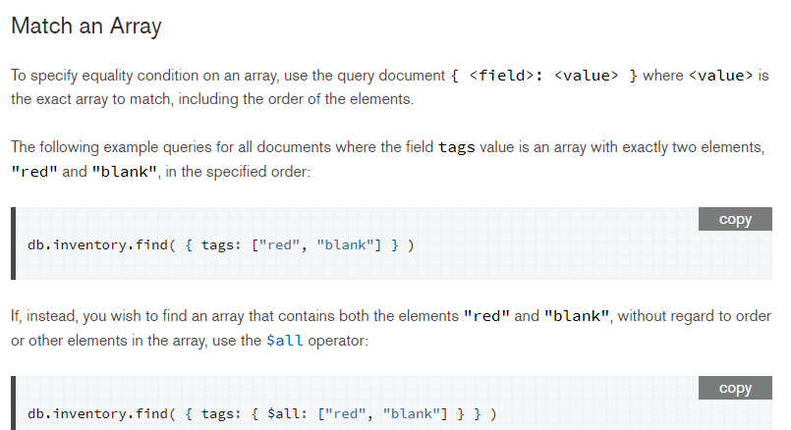

Slide 38
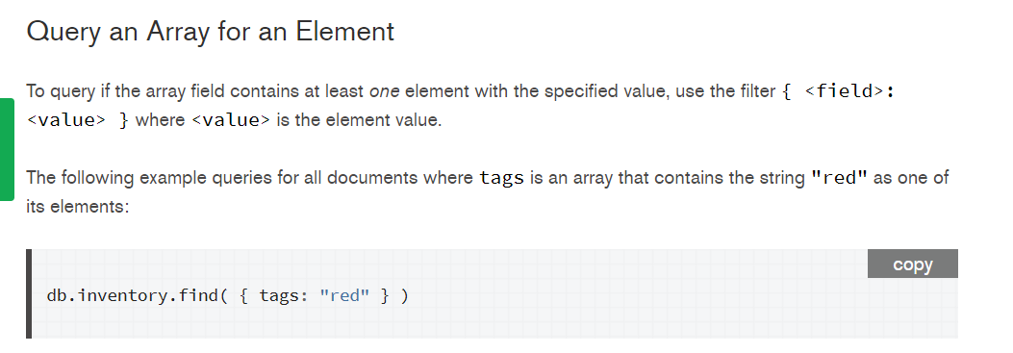

Slide 39
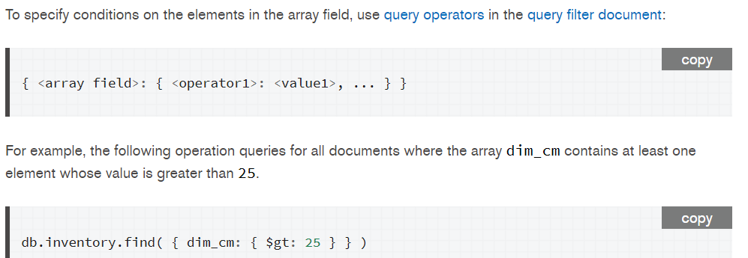

Slide 40
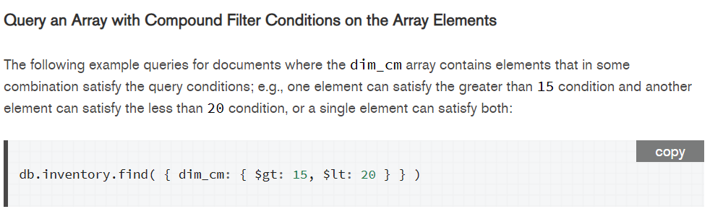

Slide 41
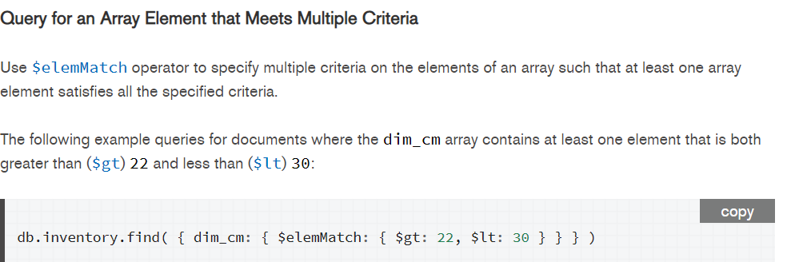

Slide 42
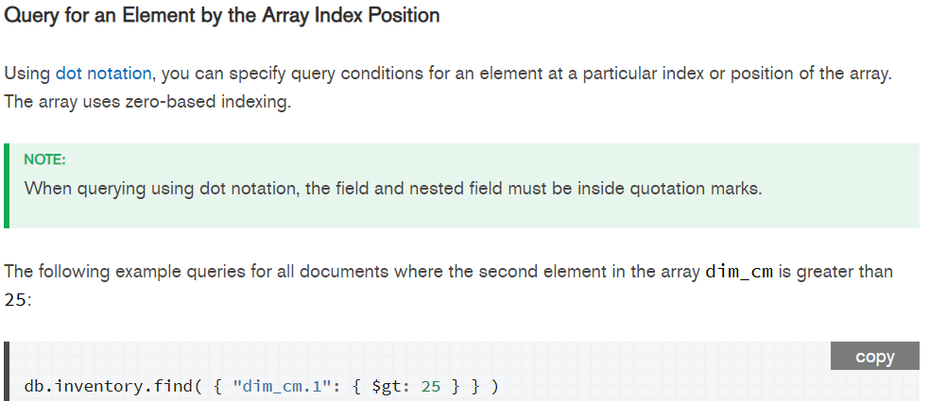

Slide 43
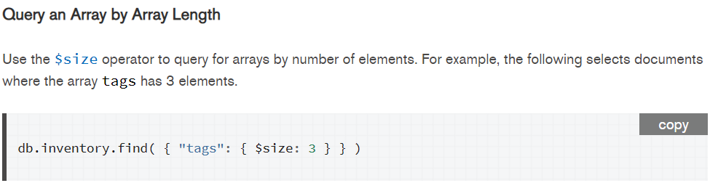

Slide 44
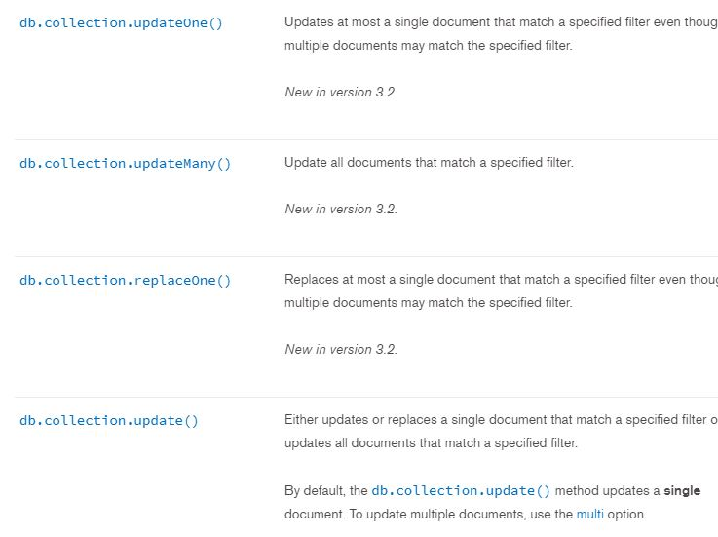
Update methods

Slide 45
